Slide 1
Control of Overall Performance
Session 38

Slide 2
Planning and control are increasingly being treated as an interrelated system. Along with techniques for partial control, control devices have been developed for measuring the overall performance of an enterprise or an integrated division or project within it -against total goals.
Many overall controls in business are financial.

Slide 3
There are many reasons for control of overall performance. In the first place as overall planning must apply to enterprise or major division goals so must overall controls be applied to the enterprise. In the second place, decentralization of authority - especially in product or territorial divisions creates semi-independent units and these must be subjected to overall controls to avoid the chaos of complete independence. In the third place, overall controls permit measuring an integrated area manager’s total effort, rather than parts of it.

Slide 4
Financial controls, like any other control, have to be tailored to the specific needs of the enterprise or the position. Doctors, lawyers and managers at different organizational levels do have different needs for controlling their area of operation. Financial analyses also furnish an excellent “window” through which accomplishment in non-financial areas can be seen. A deviation from planned costs for example may lead a manager to find the causes in poor planning, inadequate training of employees, or other non-financial factors.

Slide 5
Profit and loss control
The profit and loss (P&L) statement is a financial statement that summarizes the revenues, costs and expenses incurred during a specified period, usually a fiscal quarter or year. The P&L statement is synonymous with the income statement. These records provide information about a company's ability or inability to generate profit by increasing revenue, reducing costs or both. Some refer to the P&L statement as a statement of profit and loss, income statement, statement of operations, statement of financial results or income, earnings statement or expense statement

Slide 6
Control through ROI (reTURN ON INVESTMENT)
One of the most successfully used control techniques is that of measuring both the absolute and the relative success of a company or a company unit by the ratio of earnings to investment of capital. The return-on-investment approach, often referred to simply as ROI, has been the core of the control system of the Du Pont Company since 1919.
Return on investment, or ROI, is a mathematical formula that investors can use to evaluate their investments and judge how well a particular investment has performed compared to others. An ROI calculation is sometimes used along with other approaches to develop a business case for a given proposal. The overall ROI for an enterprise is sometimes used as a way to grade how well a company is managed.

Slide 7
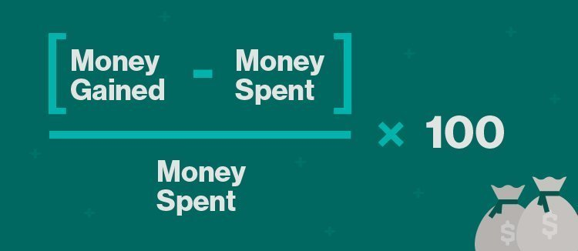

Slide 8
mANAGEMENT AUDITS AND ACCOUNTING FIRMS
Management Audit is an assessment of methods and policies of an organization's management in the administration and the use of resources, tactical and strategic planning, and employee and organizational improvement.
Businesses employ accounting firms to handle important financial tasks. Public companies must follow accounting rules set by the Securities and Exchange Commission (SEC) and following Generally Accepted Accounting Principles (GAAP).

Slide 9
bALANCED SCORECARD
The balanced scorecard is a strategy performance management tool – a semi-standard structured report, that can be used by managers to keep track of the execution of activities by the staff within their control and to monitor the consequences arising from these actions.

Slide 10
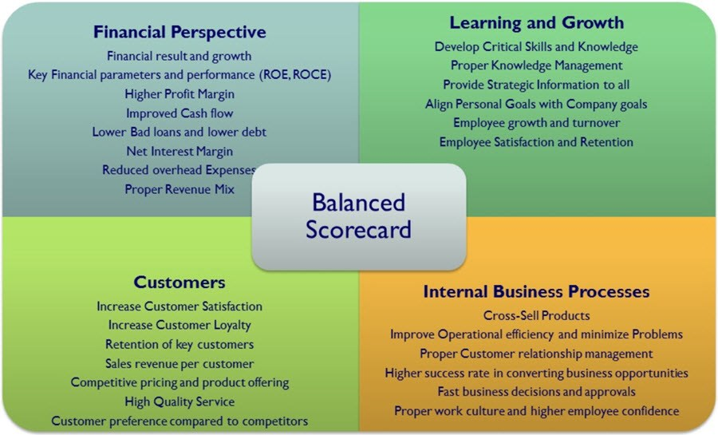

Slide 11
bureaucratic AND CLAN CONTROL
Bureaucratic control is the use of rules, policies, hierarchy of authority, written documentation, reward systems, and other formal mechanisms to influence employee behavior and assess performance. Bureaucratic control can be used when behavior can be controlled with market or price mechanisms.
Clan control represents cultural values almost the opposite of bureaucratic control. Clan control relies on values, beliefs, corporate culture, shared norms, and informal relationships to regulate employee behaviors and facilitate the reaching of organizational goals.
Organization that use clan control require trust among their employees. Given minimal direction and standards, employees are assumed to perform well - indeed, they participate in setting standards and designing the control systems.

Slide 12
Requirements for Effective controls
Session 39

Slide 13
12 important needs of an effective control system in management are:
Objectives
Suitability
Forward looking
Feedback
Quick Action
Directness
Flexibility
Economy
Regular revision
Active participation
Suggestive
Competent and talented staff

Slide 14
If controls are to work, they must be tailored to plans and positions, to the individual managers and their personalities, and to the needs for efficiency and effectiveness.

Slide 15
Tailoring controls to plans and Positions

Slide 16
Tailoring controls to Individual Managers

Slide 17
Designing controls to Point up Exceptions at Critical points

Slide 18
Seeking Objectivity of Controls

Slide 19
Ensuring flexibility of Controls

Slide 20
Fitting the Control system to the Organization Culture

Slide 21
Achieving Economy of Controls

Slide 22
Establishing controls that Lead to Corrective Action

